Slide 1
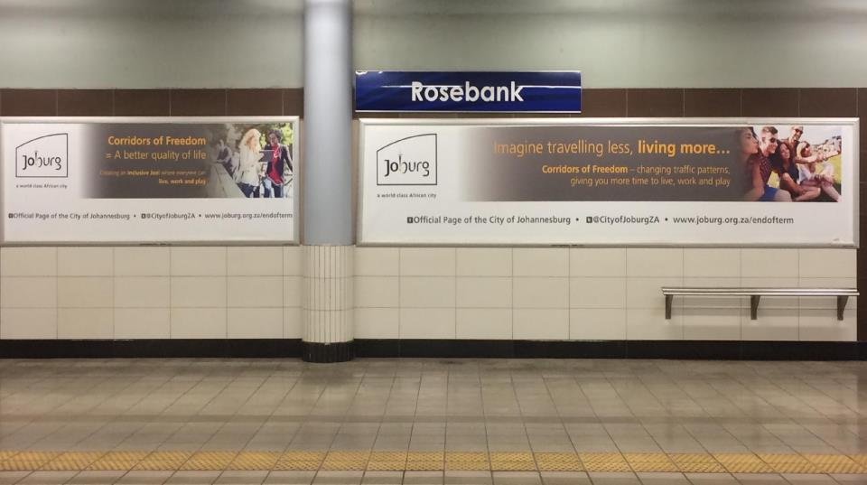

URBAN COMPLEXITIES, SPATIAL VISIONS AND
ADAPTIVE GOVERNANCE IN JOHANNESBURG
Margot Rubin and Romain Dittgen
South African Research Chair in Spatial Analysis and City Planning
University of the Witwatersrand
Moscow, 7 December 2016, Workshop, Adaptive governance and the built environment: Studies from BRICS Cities

Slide 2
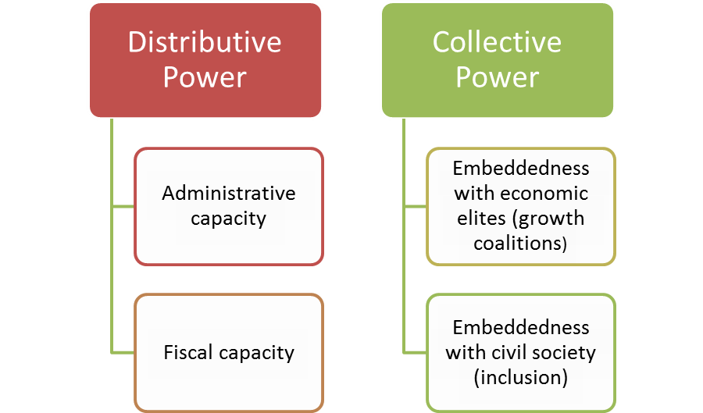

Slide 3
Factors shaping adaptive capacities
The autonomy and power within the overall system of governance nationally;
The mutually supportive relationships forged with other agents of government;
The political willingness to proactively shape the trajectory of city development;
The ability to mobilise material resources in support of intentions;
The ability to learn and to innovate;
The ability to negotiate collective visions and organise collective action.

Slide 4
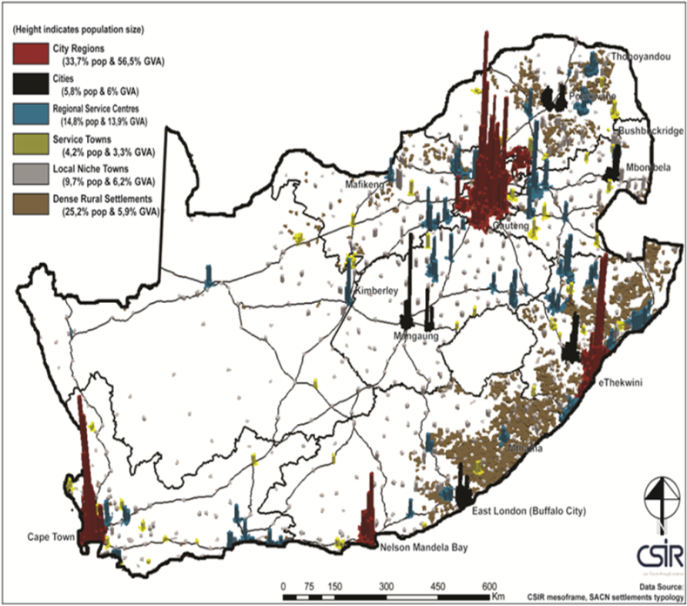
National context
Fairly rapid rates of urbanisation after the ending of apartheid following an era of “influx control”
Current urbanisation around 64% but rates of change are now slowing
Cities fragmented under apartheid with generally low densities and long distances between home and work
Slowing economic growth (2016 forecast 0.5%)
Strong concentration of urbanisation in the Gauteng heartland
Intention to transform cities but a struggle to implement with policy contradictions

Slide 5
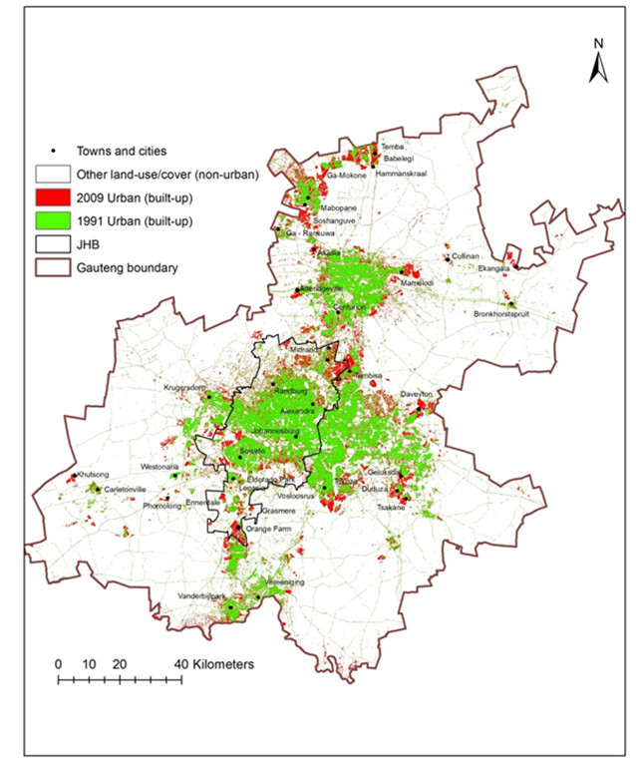
Gauteng City-Region
Same urban challenges as national but amplified because of the rate and scale of urban growth
Governance challenge as three large metropolitan cities interact with provincial government in the same space
Urban inequalities among the highest in the world (close to 0.7 Gini)
Contributes 35% of SA’s GDP but Unemployment levels of 27.6% and youth unemployment of 44%
But potentials of agglomeration in a city-region of over 13 million people which is South Africa’s gateway to Africa and the world

Slide 6
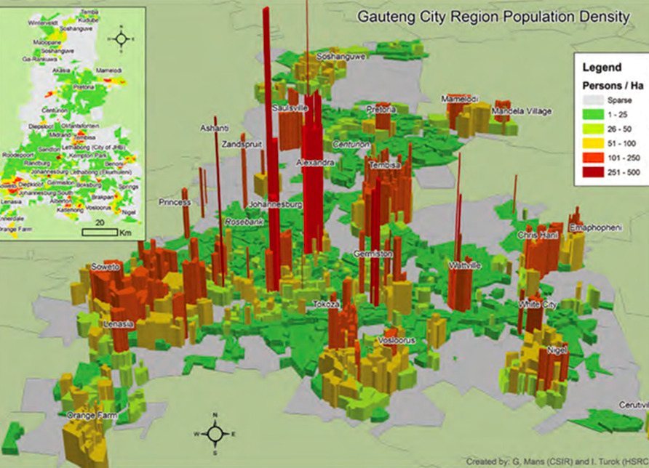

Slide 7
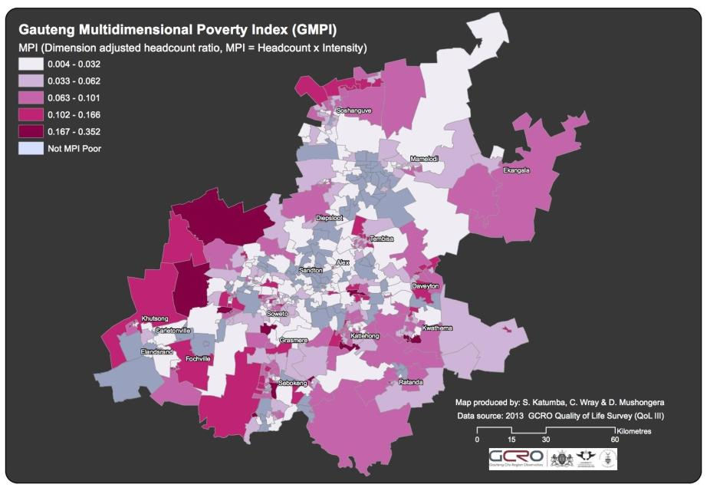
Notes:
T

Slide 8
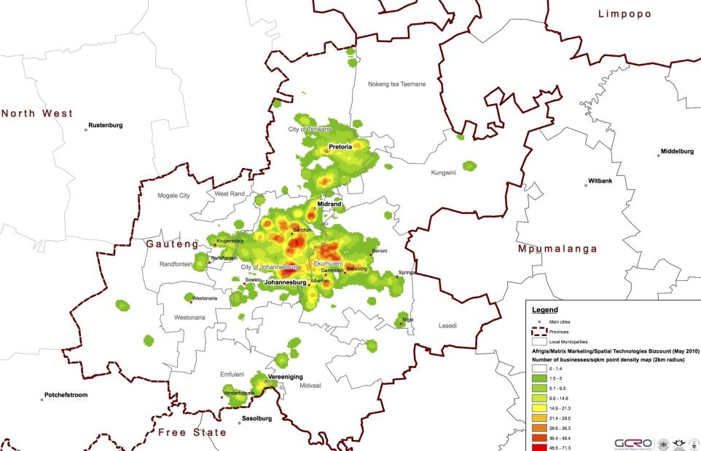
Economic activity across Gauteng
Notes:
Economic activity across Gauteng using the AfriGIS/Matrix Marketing’s BizCount 2010 database of companies to generate a hotspot analysis of the total number of firms per square kilometre, using a 2km radius scale. The map illustrates clearly that businesses concentrate in the centre of the province, clustering into a number of key nodes. It is also clear that there is much less economy in the south, far north, and outlying parts of the city-region.
http://www.gcro.ac.za/outputs/map-of-the-month/detail/economic-activity-across-gauteng/

Slide 9
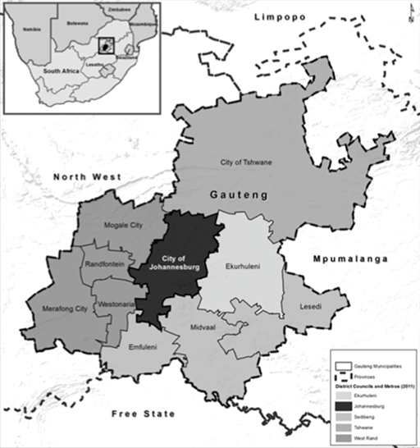
Johannesburg
A city of 4.8 million people with moderately fast growth rates (over 3% p.a)
A city with its origins in gold mining but which transformed through a manufacturing phase into a post-industrial city
A city/city-region with a complex decentralised spatial form (American style) but with the apartheid peculiarities (e.g. segregated townships on the city edge)
A city governed by a single-tier, democratically elected metropolitan authority

Slide 10
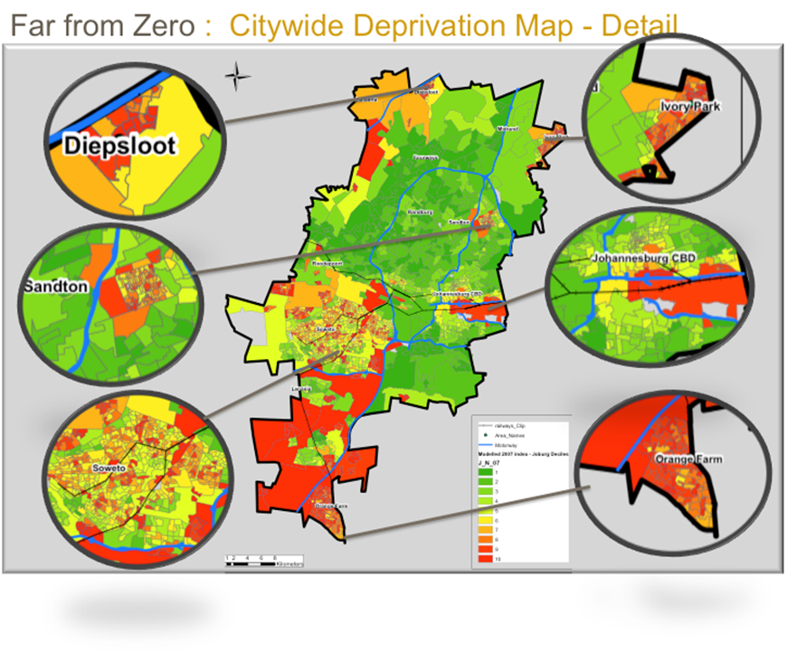

Slide 11
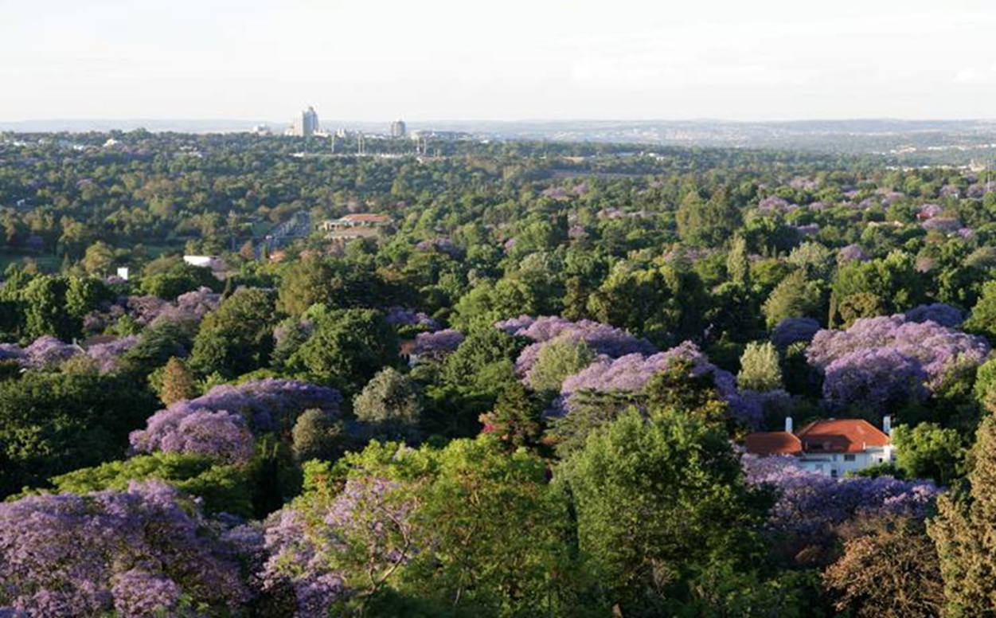
Looking north

Slide 12
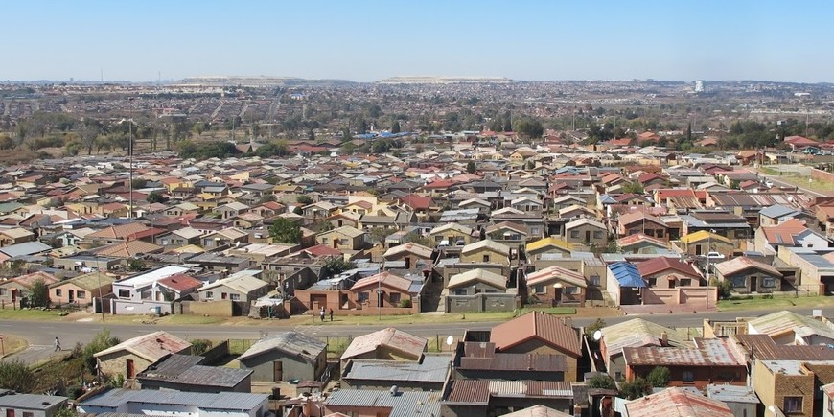
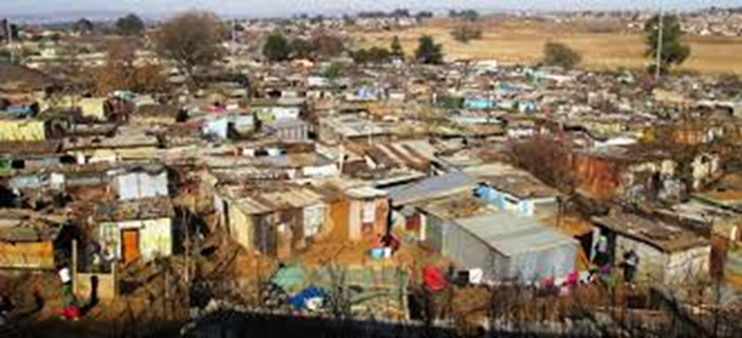
South into Soweto and Orange Farm

Slide 13
Johannesburg’s adaptive challenges
Governance – an increasingly demanding urban middle-class; alienated youth; endemic service delivery protests; difficulties in participatory structures; the complex context of the city region
Political – the ANC (“party of liberation”) was defeated in the local government elections of 2016 and has been replaced by an uneasy coalition; previous moves towards centralisation, may be strengthening in this context
Economic – the post-apartheid growth drivers (business services, expansion into Africa, demographic growth) have seemingly run out of steam; 29% unemployment feeding (once again) rising crime
Resource – water scarce and dependent on international supplies; energy shortages; changes in weather patterns; high carbon footprint; acid mine drainage
Demographic – changing migration patterns, reducing fertility ; reducing household size
Spatial – processes that are deepening spatial divides (e.g. public sector housing on the periphery, private investment in wealthy areas); much of the land is privately owned

Slide 14
In practice, South Africa’s Co-operative Governance is a hybrid between…
National
National
Provincial
Provincial
Local
Local
Notes:
The National Constitution recognises and protects municipalities as one of three equal sphere of governments
The powers of municipal government are constitutionally protected
Metropolitan cities are governed by single-tier authorities with elected councils and headed by powerful executive mayors
Johannesburg is largely fiscally self-reliant
Limits on power:
In practice the system does tend towards hierarchy with national government as the superior sphere
There is competition between provincial and metropolitan government and divergent visions
Metropolitan cities have not been given the powers to fully co-ordinate the built environment (e.g. transport and housing with land use also previously contested)

Slide 15
Autonomy and Power
Sources of power
Limit on power
The National Constitution recognises and protects municipalities as one of three equal sphere of governments
The powers of municipal government are constitutionally protected
Metropolitan cities are governed by single-tier authorities with elected councils and headed by powerful executive mayors
Johannesburg is largely fiscally self-reliant
In practice the system does tend towards hierarchy with national government as the superior sphere
There is competition between provincial and metropolitan government and divergent visions
Metropolitan cities have not been given the powers to fully co-ordinate the built environment (e.g. transport and housing with land use also previously contested)

Slide 16
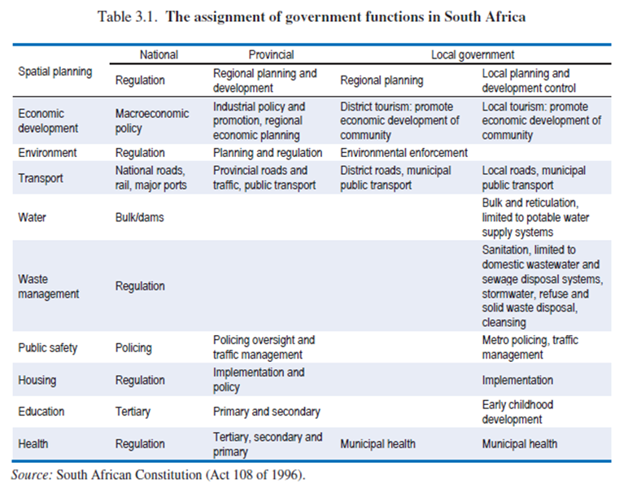
DISTRIBUTIVE POWER(S)
SHOULD | WHAT IS
Allocated powers: Constitutionally determined; has been protected by litigation | Reality is that there is contestation over: housing function, transportation and land use (amongst others)

Slide 17
Relationships within government
South Africa has a complex formal system of inter-governmental relationships that reflects the officially non-hierarchical system of governance (IGR)
A lack of coherence at national government adds to the complexity (which Department/ Minister is the city relating to?)
The nature of relationships within the GCR remain largely unresolved –
a provincial government must co-exist with three powerful metropolitan municipalities (two or which are now controlled by opposition parties)
The practice is fairly messy – divergent visions and approaches emerge periodically and are mediated through complex formal and informal political and bureaucratic engagements (and occasionally through legal action)
An example of divergence is the differing spatial vision of Johannesburg and Gauteng Province (densification-intensification vs mega projects on the edge)

Slide 18
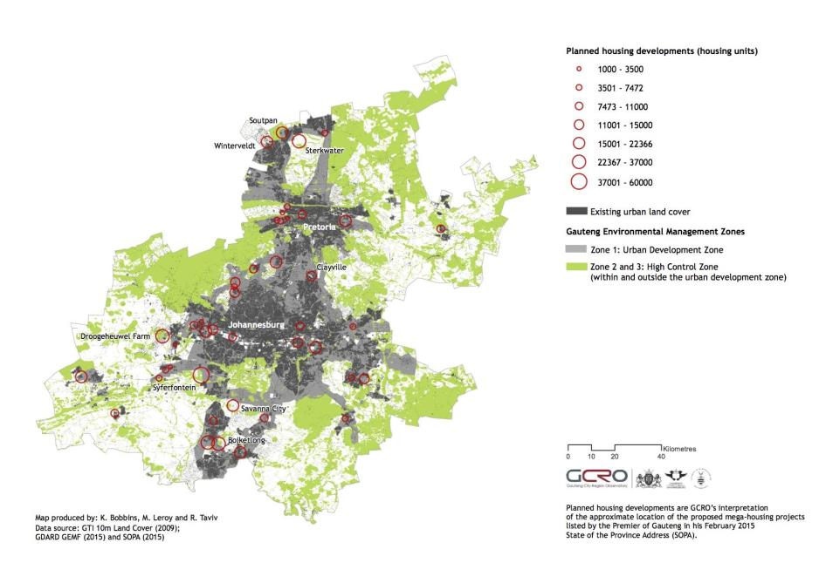
Notes:
Spatial goals
This month’s map of the month has been informed by GCRO’s previous map on the location of planned mega-housing projects published in May 2015. This is due to interest in the planned mega-housing projects and a call from the Gauteng Department of Agricultural and Rural Development (GDARD) to explore these developments in terms of the newly released Gauteng Provincial Environmental Management Framework (GPEMF). This month therefore sees the completion of the first joint map of the month between GCRO (Kerry Bobbins) and GDARD (Simon Mafu, Marc Leroy and Rina Taviv).
The map combines three digital spatial datasets namely; GTI 10m land cover, depicting all urban land classes in 2009 (in dark grey); GDARD GPEMF zones 1, 2 and 3 (light grey and green); and GCRO’s interpretation of the approximate location of the planned mega housing project developments (in red). The planned mega-housing projects have been generally located using sites identified by the Premier of Gauteng in his February 2015 State of the Province Address (SOPA).
Location of proposed mega-housing projects in terms of the Gauteng Environment Management Framework
In February 2015, the Gauteng Premier proposed a series of planned mega-housing projects for the Gauteng Province in his SOPA. Since decisive spatial change is one of the key pillars of Gauteng’s medium-term vision, the June Map of the Month looks at the alignment of the planned mega-housing projects and the Gauteng Environment Management Framework (GPEMF), which is a newly developed tool by GDARD to negotiate trade-offs between development and the environment. The map aims to identify overlaps between the general location of mega-housing projects and High Control Zones contained within the GPEMF.
The GPEMF was developed to guide, and significantly reduce, regulatory requirements for development in the Gauteng province. Gazetted in May 2015, the purpose of this tool, which aligns with the Gauteng Growth and Management Perspective (2014), is to significantly reduce the red tape associated with environmental authorisations for development and the cost of conducting business in the province.
Derived by defining desired state, environmental sensitivity and unique control areas, the GPEMF identifies five Environmental Management Zones (EMZ), which are explained in more detail in the GPEMF report available on the GDARD website (gdard.gpg.gov.za). The purpose of these zones is to inform the appropriate location for development in the province, while protecting and conserving the natural environment. In addition to the EMZs, a further six Special Management Areas are identified by the GPEMF. Each of these management areas has specific development objectives that warrant a particular management approach. Examples of these areas include the Cradle of Humankind World Heritage Site and Dinokeng.
The map indicates that the Urban Development Zone (Zone 1) identified by the GPEMF covers a much larger extent than the existing built up areas of the province, shown by the existing urban land cover layer. The map also depicts that the general location of the proposed mega-housing projects largely falls inside the urban development zone (zone 1), with five planned housing projects located outside of this zone – Droogeheuwel farm, Sterkwater, Syferfontein, Savanna City and Boiketlong. Identified to fall within the High Control Zones, these five housing projects overlap with sensitive environmental areas earmarked for conservation and/or protection. These areas of overlap flag a difference between the GPEMF and the planned mega-housing projects. For example, the Boiketlong area is located within a conservation priority zone in terms of the GPEMF. While the development is not compatible with the GPEMF guidelines for the zone, it does not mean that the development should not take place. This area shows how environmental decision support tools can be used to guide the development decision making process.
The intention of the next phase of the GPEMF is to utilise section 24(2)(d) of the National Environmental Management Act, (Act 107 of 1998) along with the EMZs to recommend the activities that may be excluded from a Zone and replaced by a Norm or Standard.

Slide 19
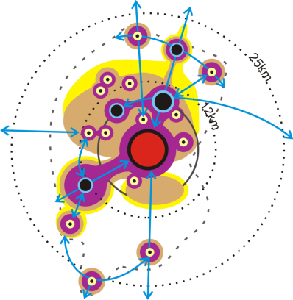
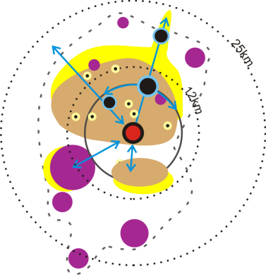
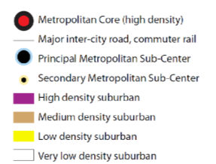
The underlying spatial rationale:
From inverted to compact polycentric city
(Source: COJ, 2015)
Notes:
Spatial Goals
Core nodes
ToD
Poeple to jobs to people

Slide 20
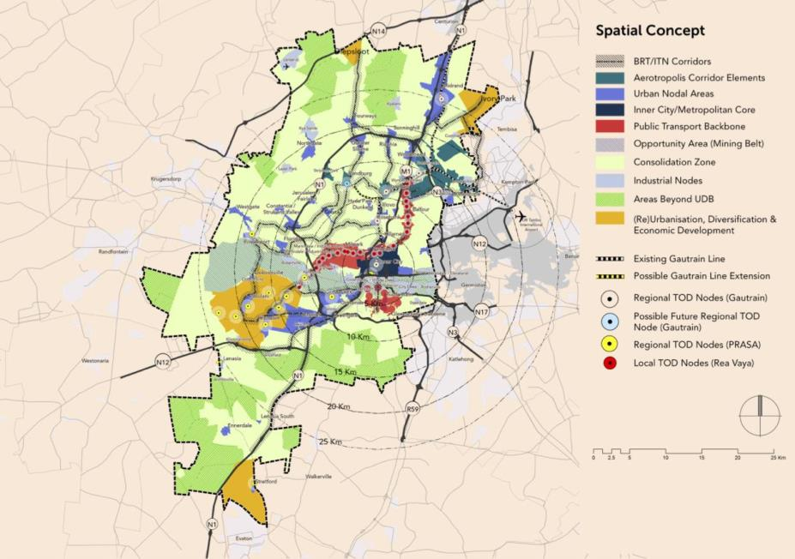
Notes:
Spatial goals
The City of Johannesburg has been proactive in terms of shaping the trajectories of urban development
A long-range development strategy has evolved since 2002 with the most recent being Joburg 2040 produced in 2011
There is also a Spatial Development Framework which actively attempts to compact and densify the city around transit networks with the Planning Department using to plan to structure the city’s capital budget
Initiatives such as the Corridors of Freedom have become flagships for socio-spatial change
The outcomes have been complex however with the overall structure of the city (the north/south divide, for example) remaining largely resilient
Problems which undermine city intentions include: the power and strategy of developers, policy contradictions (e.g. housing policy which supports edge development), patterns of land ownership, the allocations of powers (e.g. transport and housing) and resistance from existing neighbourhoods
Political change offers a new uncertainty with the new administration seemingly focussed on the shorter term

Slide 21
Willingness to shape the trajectory
The City of Johannesburg has been proactive in terms of shaping the trajectories of urban development
A long-range development strategy has evolved since 2002 with the most recent being Joburg 2040 produced in 2011
There is also a Spatial Development Framework which actively attempts to compact and densify the city around transit networks with the Planning Department using to plan to structure the city’s capital budget
Initiatives such as the Corridors of Freedom have become flagships for socio-spatial change
The outcomes have been complex however with the overall structure of the city (the north/south divide, for example) remaining largely resilient
Problems which undermine city intentions include: the power and strategy of developers, policy contradictions (e.g. housing policy which supports edge development), patterns of land ownership, the allocations of powers (e.g. transport and housing) and resistance from existing neighbourhoods
Political change offers a new uncertainty with the new administration seemingly focussed on the shorter term
Notes:
city administration most able to transform
???

Slide 22
Mobilising fiscal resources
Johannesburg is a moderately well resourced city in global terms (but international comparison is difficult as the administration does not have big spending items like health and education)
It raises finance through land taxes and service charges and is nearly self-reliant
Johannesburg participates actively in global capital markets through bond issues and has begun to experiment with land value capture
Johannesburg has aggressively sought to increase its capital budget after the global financial crisis and is now at the national treasury limit for debt to equity (45%)

Slide 23
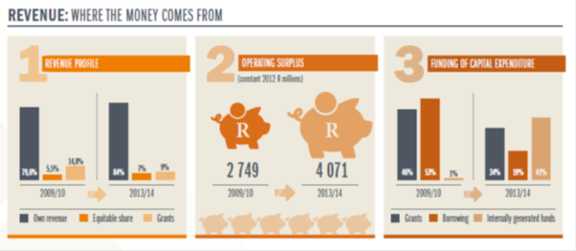
DISTRIBUTIVE POWER(S)
SHOULD | WHAT IS
Fiscal Capacity: There doesn’t seem to be lacking fiscal capacities Johannesburg generates large amount of its own revenue Planning and Treasury very powerful departments as they control some of the budget | Absolute terms (2014/2015): The effective and efficient management of its sub-directorates; Total revenue: ZAR 42 177 349 / $3 067 443 Billion Total expenditure: ZAR 38 028 448/ $2 465 705 Billion Surplus: R 4 148 901 / $301 738 Capital spending 2044/2015: R9 748 282 / $708 965

Slide 24
Human and organisational resources
Since the metropolitan city was created in 2001 the city has progressively adapted its organisational structures (although each reform has led to new challenges)
- It has centralised and regionalised; created municipal companies which it now wishes to disestablish; structured departments around long range objectives and then restructured again; amalgamated and disaggregated departments, and so on
The city with 30 000 employees is well resourced in SA terms but situation is paradoxical: there is a struggle to attract and retain professional staff but also a declining proportion of vacant positions

Slide 25
DISTRIBUTIVE POWER(S)
SHOULD | WHAT IS
Human Resource capacity: The effective and efficient management of its sub-directorates; Providing a comprehensive human resource management service to the City; Ensuring sound employee relations; Ensuring proper management of all public conveniences and managing the performance of outsourced contractors; and Maximising client and stakeholder satisfaction. | Lack of sufficient capacity across technical divisions Declining vacancies despite the city shifting operational expenditure into capital expenditure to make provision for ambitious programmes such as the Corridors of Freedom
 | 2014/2015 | 2013/2014 | 2012/2013
No of people employed | 29 723 | 30 716 | 34 923
No of positions vacant | 1391 | 4319 | 6562
Managerial positions | 2008 | 2218 | 1150
Vacant | 144 | 500 | 108
Total Vacancy % | 4.68% | 14.06% | 18.79%
cost | R8582979 | R8183161 | R7561093
Notes:
The department has identified several key objectives that must be met for Johannesburg to be a world-class African city.

Slide 26
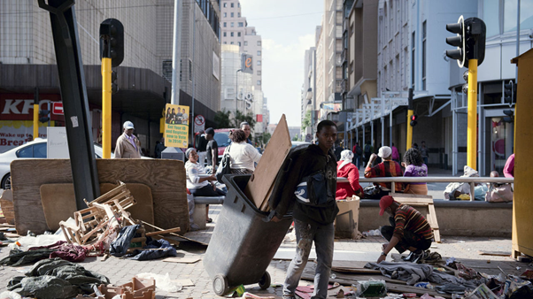
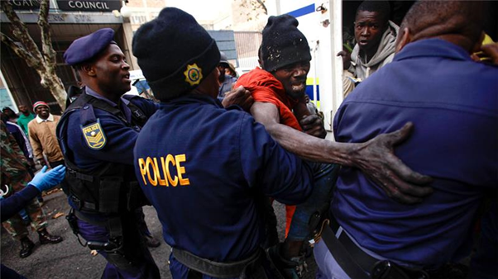
DISTRIBUTIVE POWER(S)
SHOULD | WHAT IS
A number of documents proposing goals and outcomes: highly document intensive environment: SDFs, policies etc: e.g. support informality | In practice, council does not follow its own policies; contradicts them (Operation Cleansweep); also acts in Silos

Slide 27
Learning and innovating
Johannesburg has the elements of a formal system for learning – for example, a “central strategy unit” which commissions research and feed this into policy and plan making, sits directly in the Mayor’s office
Johannesburg is also actively involved in international learning networks such as Metropolis, UCLG and C40
Nationally there is the SACN, SALGA and Dept. of Local Government – all of which carry out research and capacity building
Learning however comes informally through often through hard lessons on the street – ongoing protests, electoral setbacks, litigation etc.
A major recent study suggests that Johannesburg is a learning organisation but that learning is not necessarily systematic and adequately institutionalised
Recent innovation (including the Corridors of Freedom) came through the leadership of a globally connected mayor, Parks Tau, but there is a need to institutionalised more bottom up forms of innovation.

Slide 28
Negotiating futures and mobilising support
The cities plan-making has been largely technocratic with institutionalised forms of participation
There have been moments of more collaborative process (e.g. the inner city partnership but these have been rarely sustained)
The weakness in building and sustaining broad-based coalitions may have been the undoing of the recent ANC-led government, especially with the loss of support from the black middle class and what seems to be the decision of poorer urban residents not to vote

Slide 29
Illuminating capability through a case study
The city administration is complex and evolving and it is impossible to get a full grasp on its real capabilities taking a macro perspective
A case-study help illustrate actually existing capabilities although the case does not always represent the city as a whole
  What is the capability of the city in relation to a project of this ambition, and what does a project like this say about the capability of the city as a whole
  In light of existing challenges and considering the capabilities of local government, to what extent are the COF a catalyst for new approaches to governance and new relations between actors?
Notes:
light of the existent challenges and distribution/capabilities of local government functions, to what extent do the COF bring about (governance) innovations in responding to these?
Divide it up: preexistent conditions in the City to implement and promote this idea, to shape space, to get buy in (which speaks to adaptive governance)
On paper it looks fine (rhetoric), but reality is far more problematic.
Question about what hat the city can and cannot do
This is the lens we’re using in order understand, highlight, bring into focus, analyse broader issues

Slide 30
CoJ: Remaking the existing city
- In 2013, Mayor Tau announces the corridors of freedom as one of the city’s flagship programmes and as the key instrument for spatial transformation
- This follows a long history of attempts to transform the city beginning with the late apartheid critique (late 80s) of the racially divided sprawling city
- From around 2006, transit-oriented development had been a key element of the city’s densification strategy linked to the implementation of a BRT system
- What distinguishes the corridors of freedom is the high level political support and profile given to a strategy which had previously been largely technical and bureaucratic
Notes:
Some context:The Corridors of Freedom is revealing as a high-profile mayoral project with a clear intention to remake the city
Future planning must address sustainability and inequity
most efficient urban form is compact, mixed land-use with an extensive public transport network (high intensity movement corridors)
Idea that compact city is energy efficient + greater access to services, promotion of social cohesion, creation of vibrant urban environment.

Slide 31
Outlining the Corridors of Freedom
The Corridors of Freedom are envisaged as a way to restitch the apartheid city and as a remedy to modernist car oriented urban form
It involves incremental mixed-use brownfield development, inclusionary housing and densification along accessible transit (mainly BRT) routes
As a mayoral project it has high profile within the city and as a priority within capital budgets
It is city initiated and planned but relies on private sector response
Bulk infrastructure is funded through the city’s budget with the financing raised through issuing green bonds and medium term loans secured through anticipated increasing property values
To date, first-phase planning and infrastructure upgrades, incentives and negotiation with developers and some land banking
Notes:
Key features of CoF:
safe neighbourhoods designed for cycling and walking (NTM) + attractive street conditions
Mixed-use dev. where residential areas, office parks, shops, schools and other public services are close together, stimulating economic activity and creating opportunities
‘Rich and poor, black and white living side by side’ - housing options provided cover a range of types and prices
…
Idea that developing dedicated transport corridors holds a number of advantages for Joburg:
Focus on productive land use and economic activities where transport infrastructure already existent or planned
public transport seen as a viable alternative (because residents will live closer to work, shopping and leisure activities)
High-density housing => stimulate opportunities for the SMME sector and small-scale operators in the informal sector
Citing a number of examples linked to economies of agglomeration
(drawn from CoJ Website on COF)

Slide 32
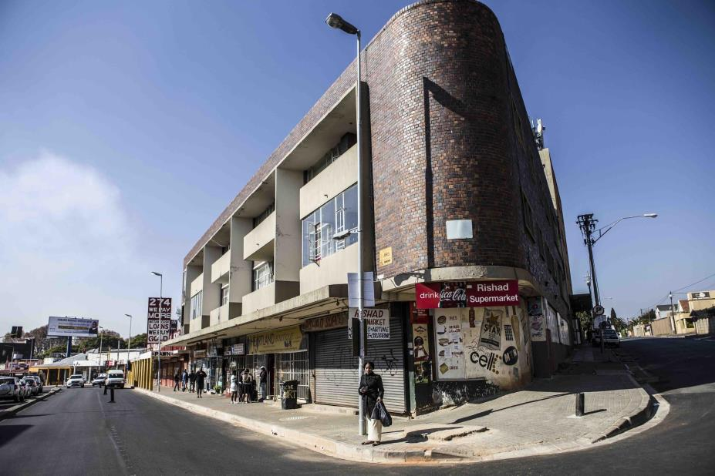
(© Mark Lewis, 2016)
Notes:
Louis Botha
Some of those images highlight the challenges - poverty, informality, marginalisation -- issues that the CoF is trying to address, also refer to the diversity of communities along the corridors

Slide 33
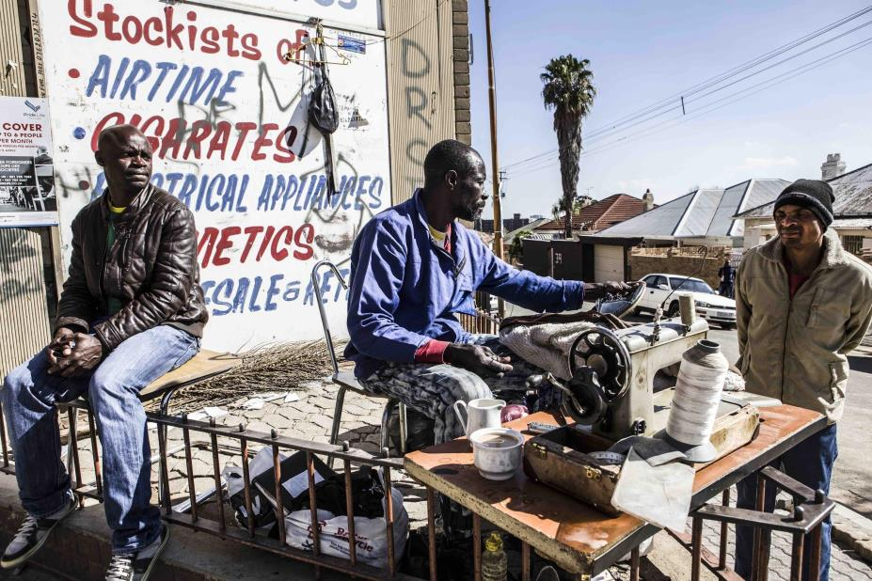
(© Mark Lewis, 2016)
Notes:
Louis Botha

Slide 34
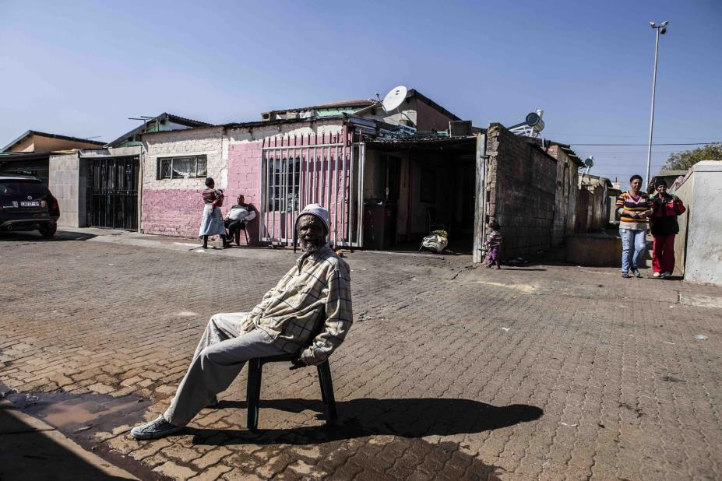
(© Mark Lewis, 2016)
Notes:
Westbury --

Slide 35
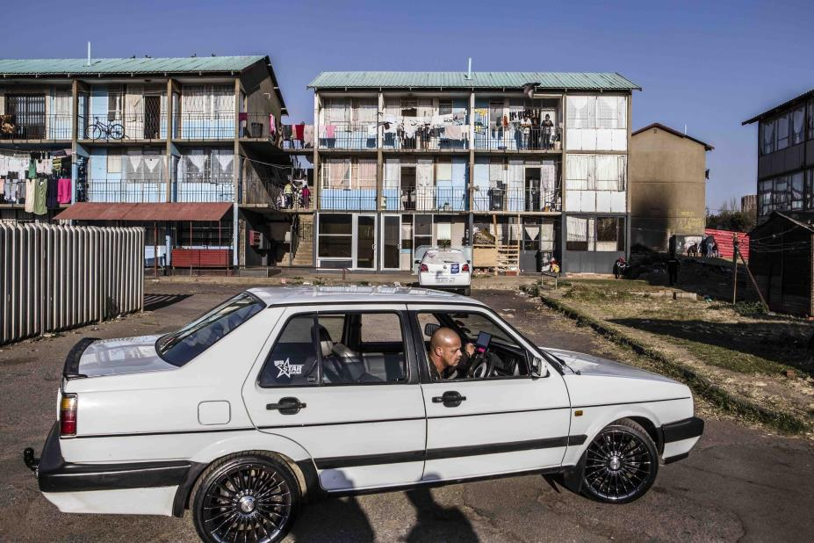
(© Mark Lewis, 2016)
Notes:
Westbury --

Slide 36
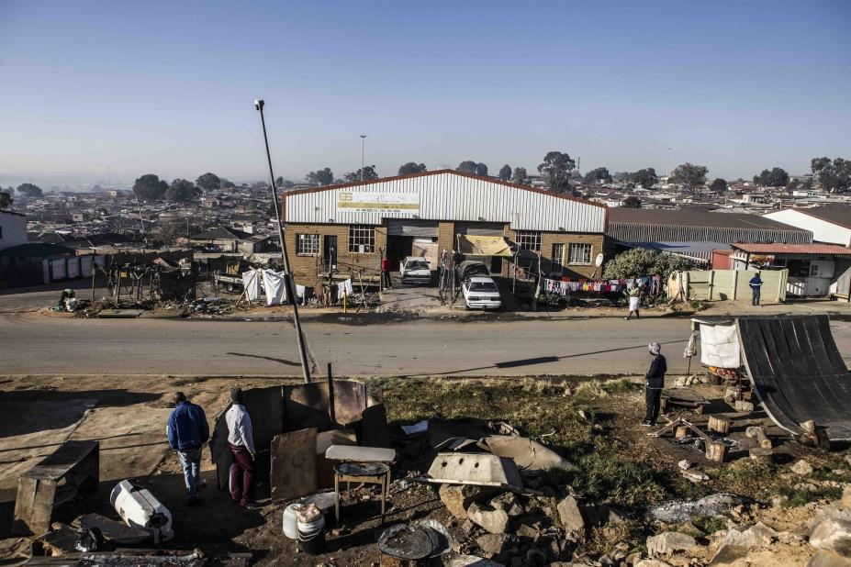
(© Mark Lewis, 2016)
Notes:
Marlboro South

Slide 37
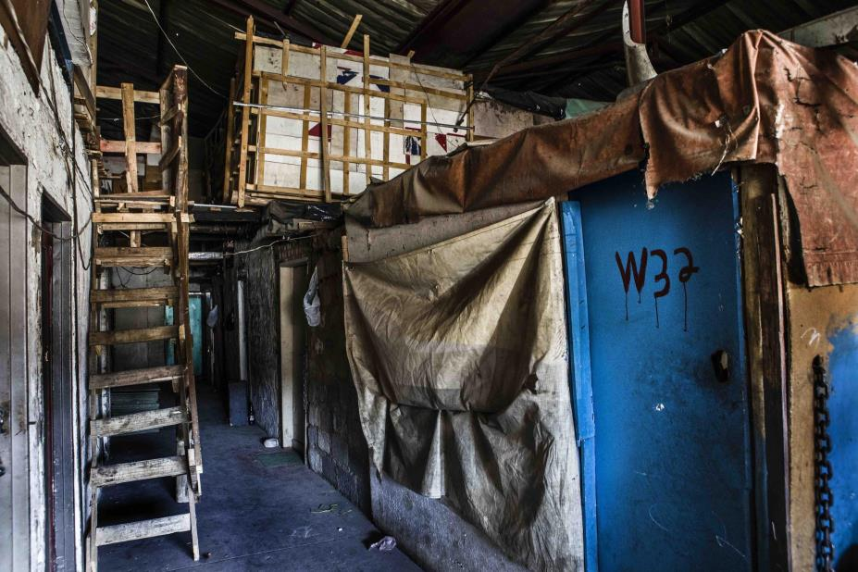
(© Mark Lewis, 2016)
Notes:
reclaimed spaces within abandoned warehouses

Slide 38
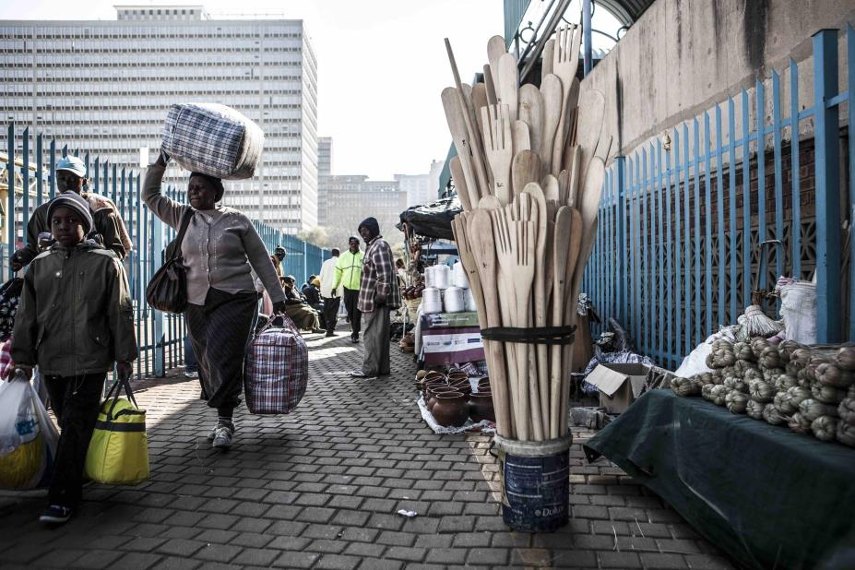
(© Mark Lewis, 2016)
Notes:
Park Station -- space of intense and diversified forms of mobility

Slide 39
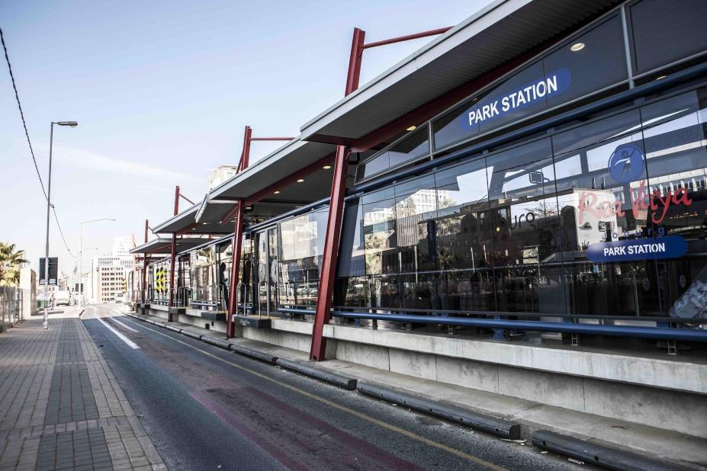
(© Mark Lewis, 2016)
Notes:
Park Station -- BRT station

Slide 40
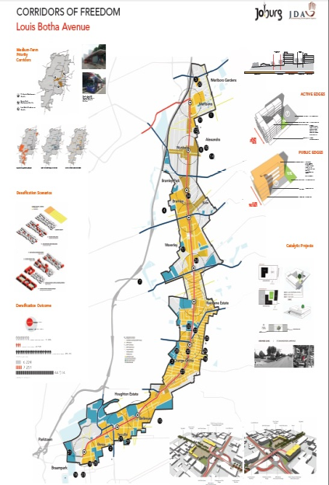
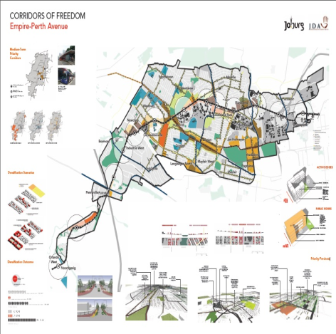

Slide 41
Collective and Distributive Powers
Collective Power
Distributive Power
Allocation of powers and functions to different spheres of government
Discrepancies between policy and practice
Human resource capacity to implement
Fiscal Capacity
Notes:
Either complete or delete slide

Slide 42
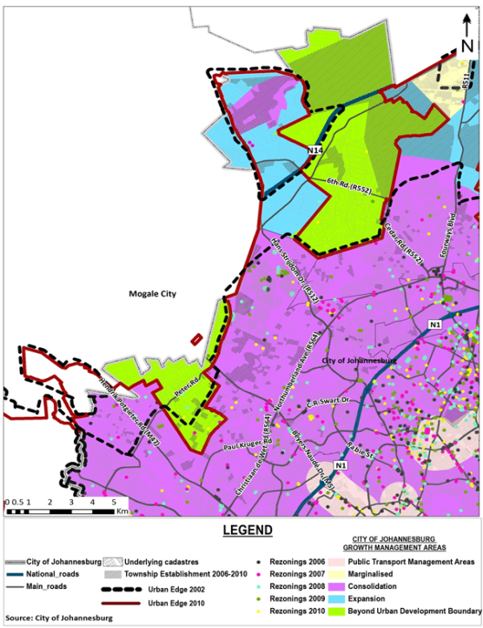

Slide 43
COLLECTIVE POWER(S)
SHOULD | WHAT IS
COF is promoting a pro-poor agenda and a people-centred city “...majority of working class and poor citizens are still living on the fringes of the CBD and have to commute distances to get to work.” “...increased freedom of movement as well as economic freedom” | In reality, developmental imperatives by the CoJ are confronted with market-driven tendencies of the private sector (CoJ unable to implement COF on its own) Building (where and what?) Risk of continued social exclusion and gentrification?
Create a ‘guided’ enabling environment to direct private investment into specific areas A range of incentives to “seduce”: including new cost-cutting development mechanisms; tax rebatements Confidence that public investments will lead to private sector interest | Developers: location and yields; cautious and risk averse Benefits versus obligations Often, incentives all on the supply side instead of the demand side Issues of trust and disparities in the nodes in the COF
Notes:
Collective consensus – ability to convince third parties
Now beginning to understand what is happening in a very limited way but very late as many of the decisions have already been taken and are operating irrespective of what actually exists on the ground
Promise of densification bonuses and tax rebates but hasn’t come through – history of mistrust

Slide 44
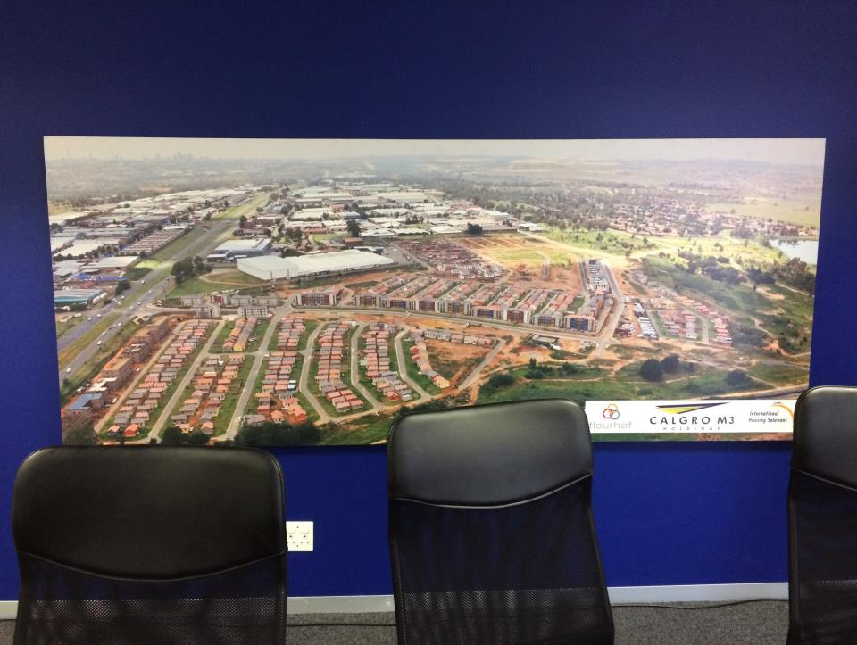
Notes:
Talk about the role of property developers in this project. Difference between the ones that are interested in considering investments in the CoF and those whose interests lie outside (big, small players…)
IHS and Growthpoint -- both are tentatively looking at it.

Slide 45
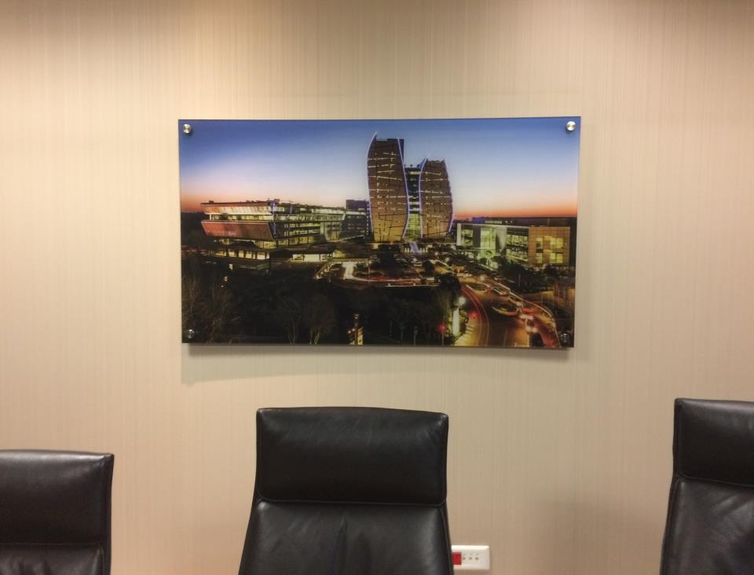
Notes:
Growth Point -- based in Sandton. Mainly commercial developments (Office, commerce, industry)
Reinforcing historic nodes – importance – maintained spatial dynamics of core periophery
Actual ability of the city to reshape the city
Ineffective in any case land value capture

Slide 46
COLLECTIVE POWER(S)
SHOULD | WHAT IS
Supposed to leverage all parts of the private sector including the banks | However, not entirely convinced - too high a risk and an unproven track record
Different levels of planning (IDP, SDF, RSDF, precinct planning, BEPP) to help articulate and complement layers of the initiative | COF remains partly conceptual as implementation is incremental and sequenced Many of the departments internally have not invested in the idea of the CoF

Slide 47
COLLECTIVE POWER(S)
SHOULD | WHAT IS
High levels of Public consultation and engagement One of the CoJ’s flagship projects with high resonance | Lack of communication The initiative began as a big announcement without lead-up participation This was followed by top-down and technocratic engagement (box ticking in the invited spaces) Differentiated levels of engagement (e.g. Patterson Park)
Significant investments into public transport will lead to change in behaviour Public transport seen as a viable alternative (because residents will live closer to work, shopping and leisure activities) High-density housing will stimulate opportunities for the SMME sector and small-scale operators in the informal sector | Weak correlation between material changes and social behaviour Consider fixity of human behavior and of predominant social aspirations (freestanding house, car); lack of integrated transport system Weak economy and slow growth
Notes:
Legislation – MSA – people to be involved in decisions that effect them
Correlated with income levels to respond – technical capabilities
Ability to change psychology
Manufacturing consent

Slide 48
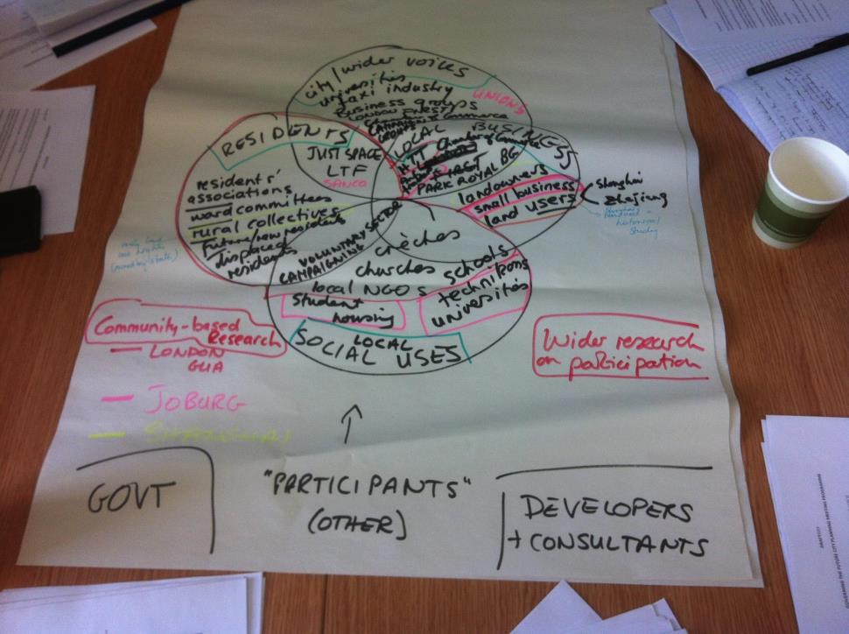

Slide 49
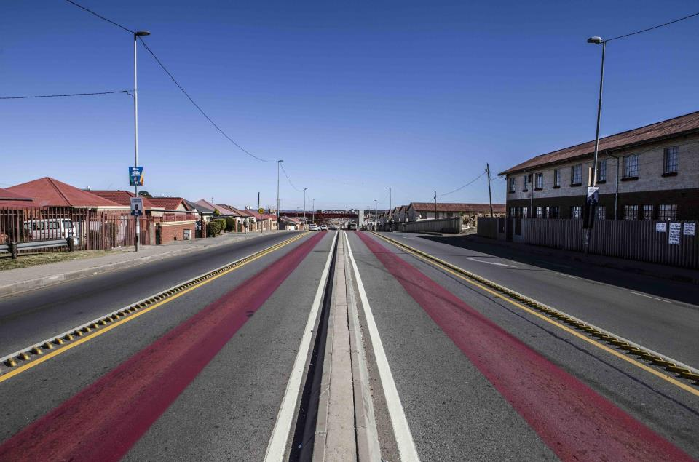
(© Mark Lewis, 2016)
Notes:
‘the devil is in the detail’ -
Different ways of defining notions such as ‘accessibility’ (differences across the corridors)
BRT separating two communities (Westburg/Coronationville), along LB island in the middle bad for business...
Discrepancy between intervention and the needs

Slide 50
Insights from the CoF
The case-study confirms the innovative and learning capacities of the city administration but this was dependent on a progressive mayor
The city had the capacity to re-align budgets around the CoF and to a certain extent realign operational plans of city departments and agencies
The actual HR capacity for implementation however is extremely limited relative to the ambition of the project – a few committed individuals trying to restructure the entire city
The CoF has highlighted policy contradictions and tensions e.g. the lack of a strong framework on inclusionary housing, a lack of understanding the economic imperatives

Slide 51
Insights from the CoF
The project requires the city to operate differently but the full implications of what this means is still not clear
The project was implemented technocratically but nearly came adrift with local opposition (especially to densification) requiring a more participatory mode but the tensions between inclusion and pacifying the middle class remain
Intergovernmental relations and tensions have undermined the project with a different vision for the urban future coming from provincial government
The project is requiring different modes of engagement with developers – with the city having traditionally been reactive.
This is a long term project of incremental development that requires systematic and sustained attention from city government (bureaucratic capacity) but more importantly requires the relational capacity to embed the initiative within broader governmental structures and within private sector decision-making)

Slide 52
So what does this all mean?
On the one hand…
Johannesburg has the powers provided by a national constitution and the authority of a single tier metropolitan structure
It is almost self-reliant financially and has the resources to implement a reasonably ambitious capital programme
It has been organisationally adaptive
It has shown the political willingness to construct long term transformative visions which have evolved and strengthened over time
Its plans are regarded as cutting-edge in international terms reflected for example, in the election of former Mayor, Parks Tau, as global president of the UCLG

Slide 53
So what does this all mean?
On the other hand..
The constitutional framing is immensely complex requiring multiple levels of formal and informal interactions within and across scales of government (city-region governance unresolved)
The allocation of powers is inadequate to enable proper coordination of built environment powers at local level
At times there is a mismatch between progressive policy intentions and actual practices on the ground (e.g. Operational Clean Sweep) as the city struggles to respond to multiple imperatives
Despite the history of “struggle” and “political activism” the city administration has taken a fairly technocratic approach, although with a gradual shift to more collaborative forms of plan-making
The city is possibly at the limits of its capital spending and its professional capabilities are limited in relation to its ambitions (as illustrated, for example, in the growing vacancies)

Slide 54
What is the significance of the Johannesburg experience?
It represents a decade-and-a-half of experience with single-tier metropolitan governance (rare in global terms)
It reveals the difference between adaptation in policy and intentions (in which Jo’burg has done well) and adaptation in actual delivery (in which the outcomes are ambiguous)
There is a temporal story of change over time
There is a quite complex story of multi-layered scales (with a city-region perspective often quite different from a city perspective)
Intersectionality: not all groups share interests but where interests do align – extremely potent spatial actors

Slide 55
With many thanks to the…

